Slide 1
Individual and organizational narcissism
Seyyed Babak Alavi
Graduate School of Management and Economics
Sharif University of Technology
Keywords: Narcissism, narcissistic leadership, organizational narcissism, social identity theory

Slide 2
Narcissism
Derived from the Greek myth of Narcissus, a young man fated to fall in love exclusively with the perfection of his own reflection;
The term “narcissism” was coined by Ellis (1898) to describe a clinical condition of “perverse self-love” although Freud had great impact on research of this topic in academic contexts.

Slide 3
Types of narcissism
Normal/Healthy: shows a positive self-esteem and facilitate normal functioning and creativity.
Pathological disorder: disability to integrate the idealized beliefs about oneself with the reality of one’s inadequacy.
Rosenthal, S. A. & Pittinsky, T. L. (2006). Narcissistic leadership, The leadership quarterly. 17, 617-633.

Slide 4
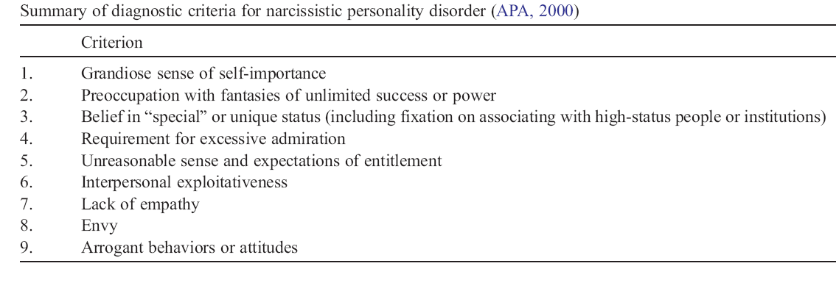
Narcissistic personality disorder
Source: Rosenthal, S. A. & Pittinsky, T. L. (2006). Narcissistic leadership, The leadership quarterly. 17, 617-633.

Slide 5
Six psychological dispositions of narcissism
Denial
Rationalization
Self-aggrandizement
Attributional egotism
Sense of entitlement
anxiety
Brown, A. D. (1997). Narcissism, identity, and legitimacy, The Academy of Management Review, 22 (3), 643-668.

Slide 6
Narcissistic leadership
Leaders with normal narcissism are faithful to their visions, risk takers, reasonably confident and optimistic.
Leaders with pathological narcissism are very sensitive to criticism and poor listeners, and lack empathy for others and have an intense sense of competition and tendency to unreasonable risks.
Maccoby, M. (2000 January-February). Narcissistic leaders: The incredible pros, the inevitable cons. Harvard Business Review, 69-77.

Slide 7
A narcissistic organization
“A narcissistic organization is one in which the organization is felt by its members to be very special and to embody unique qualities.” (Stein, 2003, p.529).
When all or most organization members gain their self-esteem by relating themselves to their organizational identity, a narcissistic organization may be developed (Brown, 1997).
Stein, M. (2003). Unbounded rationality: Risk and organizational narcissism at Long Term Capital Management,
Human Relations, 56 (5), 523-540.

Slide 8
Social identity theory
Identification refers to a perception of oneness with or belongingness to a social category.
Organizational identity may be a part of an employee’s identity.
According to social identity theory, joining a group or an organization may be a self-regulating mechanism in order to maintain and enhance self-esteem.

Slide 9
Some characteristics of a narcissistic organization (Stein, 2003)
Exaggerated pride (hubris)
The organization deludes itself into believing it has powers with no limits (omnipotence).
Believing the organization has complete knowledge of environment, with nothing lying beyond their ken (omniscience).
Being dismissive of other organizations, people, and information; a sense of independence (dismissiveness and triumphant contempt).

Slide 10
Why studying narcissistic organizations?
It has been proposed that organizational narcissism may be an important reason for the fall of some organizations (Levinson, 1993; Stein, 2003).
Lack of attention to environment, denying required changes, entering new activities with inadequate competencies, and a low level of organizational learning are examples of mechanisms of how this phenomenon may put organizations in danger.
Levinson, H. (1994). Why the behemoth fell: Psychological roots of corporate failure, American Psychologist, 49, 5, 428-436.

Slide 11
Some practical recommendations for organizational leaders
Ask frank, sincere, and trusted advisors to give you authentic information from the inside and outside of the organization;
Constantly evaluate different aspects of the organization and compare the results with other similar organizations;
Have open periodic conversations with different stakeholders in order to collect authentic information;
Avoid developing a top management team who just simply confirm the organization strategies and policies without adequate assessment of their strengths and weaknesses.
Ask people around you to factually assess the impacts of the events on your organizations from different perspectives.

Slide 12
Some research topics for future investigations
Relationship between organizational narcissism and organizational learning;
Relationship between organizational narcissism and readiness for change;
Relationship between organizational narcissism and interpretations of facts during strategic planning;
Relationship between charismatic leadership and organizational narcissism;
Relationship between organizational narcissism and organizational ethical behaviors.

Slide 13
Thank you!

